Slide 1
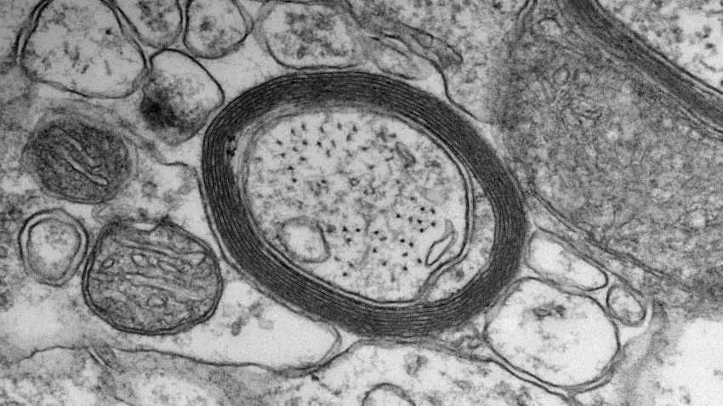
Myelin gets on my nerves
Austin Passaro

Slide 2
Structural organization of the human body
Cell – basic building block of living organisms (e.g., neuron, muscle cell, skin cell, blood cell)
Tissue – group of similar cells (of one or several types) that work together to perform a specific function (e.g., nervous tissue, muscle tissue, connective tissue, epithelial tissue)
Organ – distinct structure composed of multiple tissues that performs one or more physiological functions (e.g., brain, heart, lungs, kidneys)
Organ system – group of organs that perform a coordinated function (e.g., nervous system, circulatory system, musculoskeletal system)
Organism – living being that can independently perform all necessary functions of life (e.g., human)
Organism
Organ systems
Organs
Tissues
Cells
Notes:
https://open.oregonstate.education/aandp/chapter/1-2-structural-organization-of-the-human-body/

Slide 3
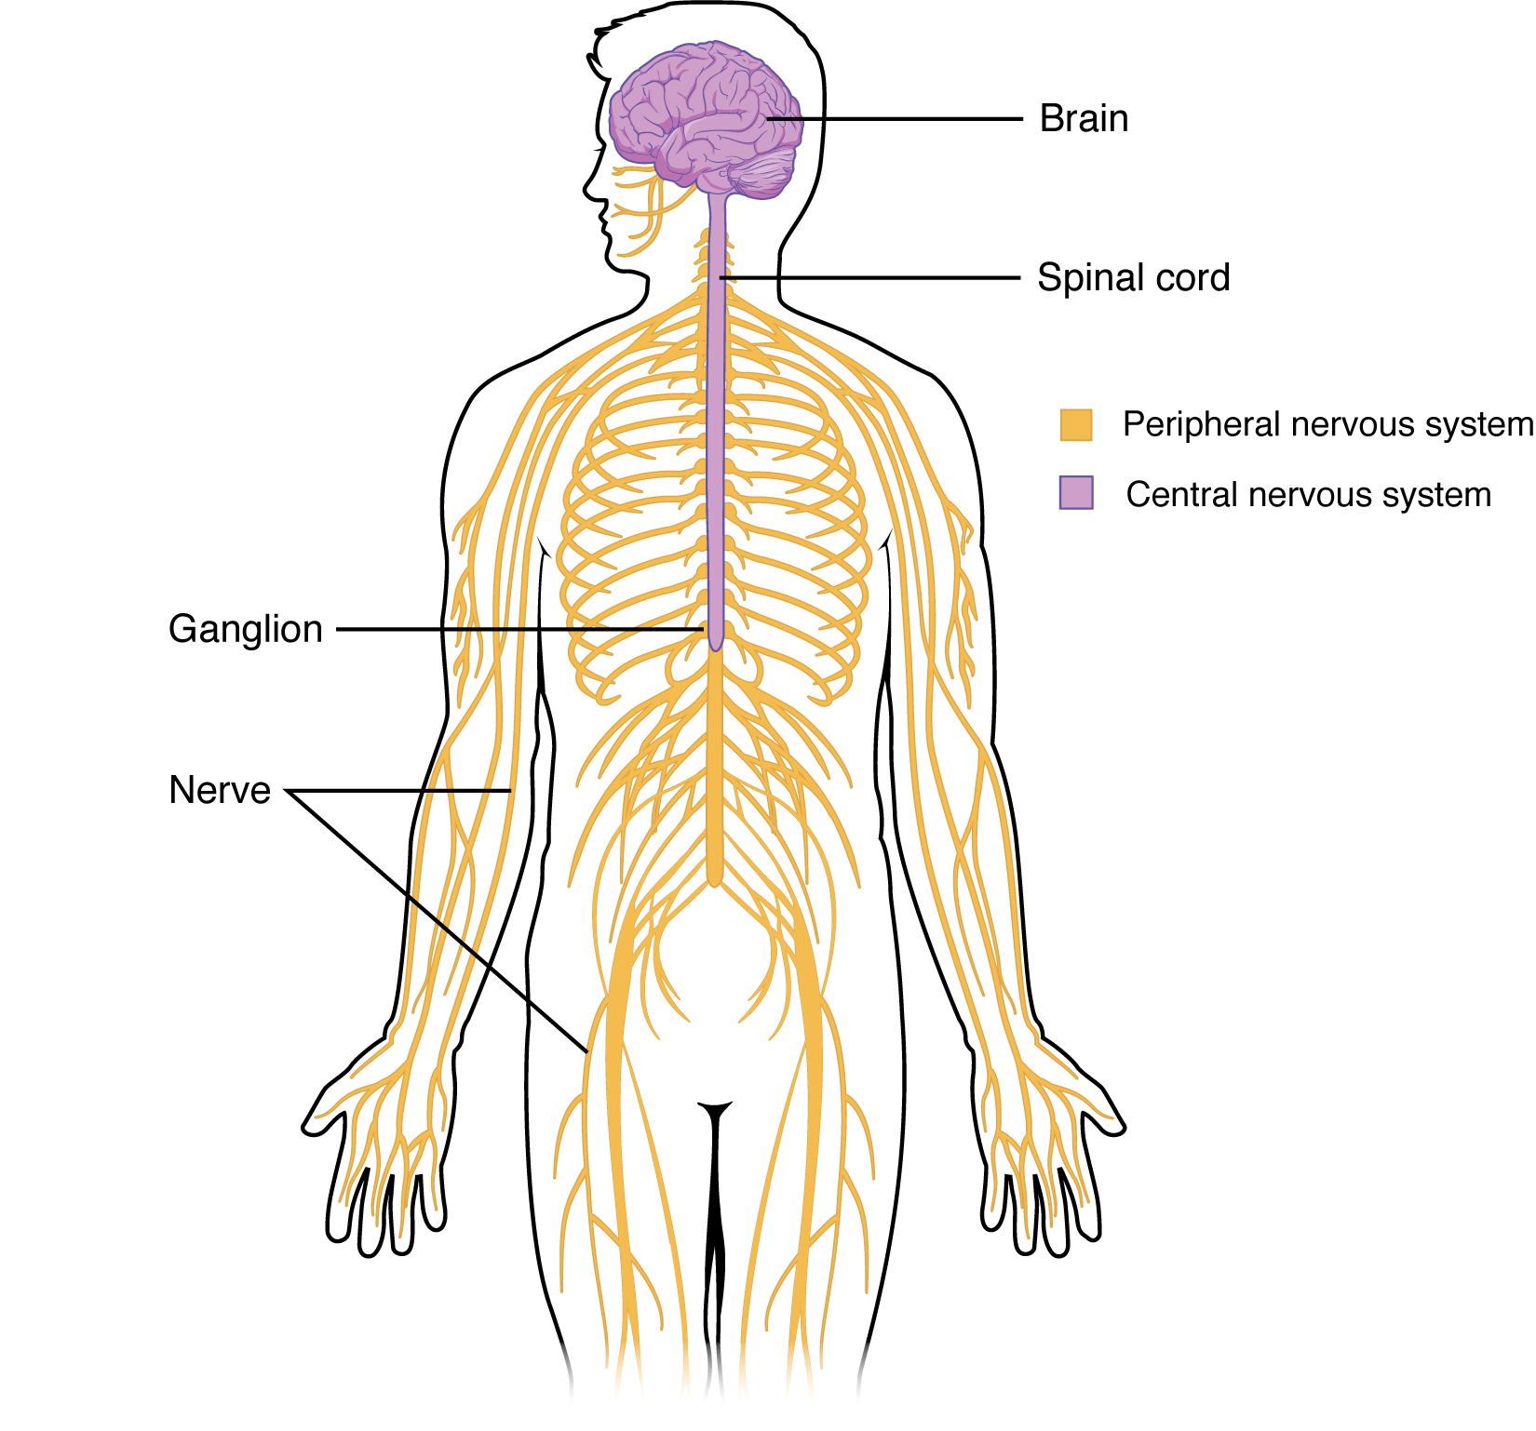
Nervous System
Central nervous system
Peripheral nervous system
Organism
Organ systems
Notes:
https://open.oregonstate.education/aandp/chapter/12-1-structure-and-function-of-the-nervous-system/

Slide 4
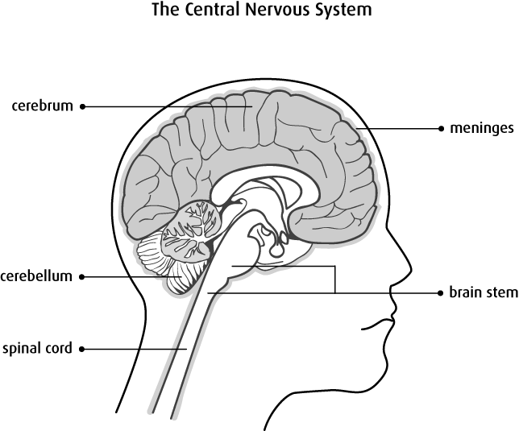
Organs
Central nervous system
Brain
Organism
Organ systems
Organs
Notes:
https://www.cancer.ca/en/cancer-information/cancer-type/brain-spinal/brain-and-spinal-tumours/?region=on

Slide 5
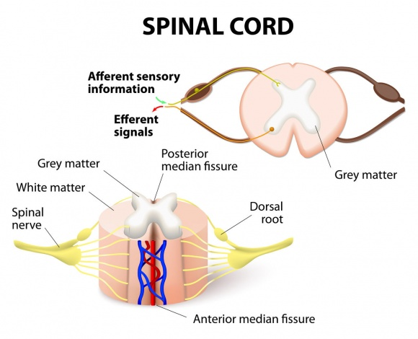
Organs
Central nervous system
Brain
Spinal cord
Organism
Organ systems
Organs
Notes:
https://www.spineuniverse.com/anatomy/spinal-cord-nerves-brain

Slide 6
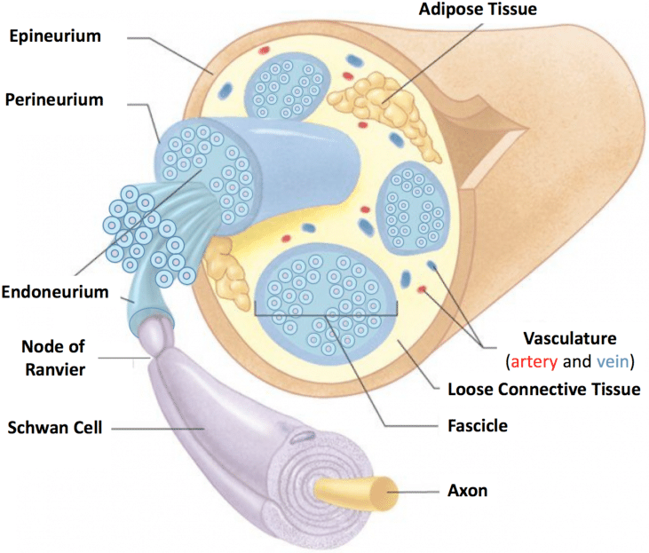
Tissues
Peripheral nervous system
Nerves
Bundles of neurons held together by connective tissue
Protect individual neurons and creates functional groupings
Organism
Organ systems
Organs
Tissues
Notes:
Kuliasha, Cary & Spearman, Benjamin & Atkinson, E.W. & Furniturewalla, A. & Rustogi, P. & Mobini, Sahba & Nunamaker, E.B. & Brennan, A. & Otto, Kevin & Schmidt, C. & Judy, J.W.. (2018). ROBUST AND SCALABLE TISSUE-ENGINEERINED ELECTRONIC NERVE INTERFACES (TEENI). 46-49. 10.31438/trf.hh2018.13.

Slide 7
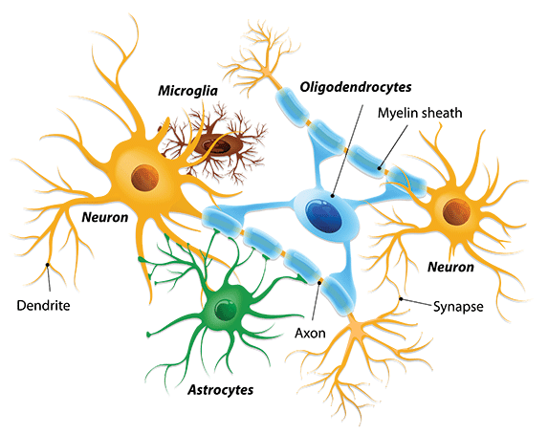
Cells
Neurons
Main cellular component of the nervous system (functionally)
Allows for communication with other neurons or tissues, such as muscle
Glia
Astrocytes – support functions
Microglia – immune response
Oligodendrocytes – myelination (CNS)
Schwann cells – myelination (PNS)
Organism
Organ systems
Organs
Tissues
Cells
Notes:
https://www.sciencenewsforstudents.org/article/scientists-say-glia

Slide 8
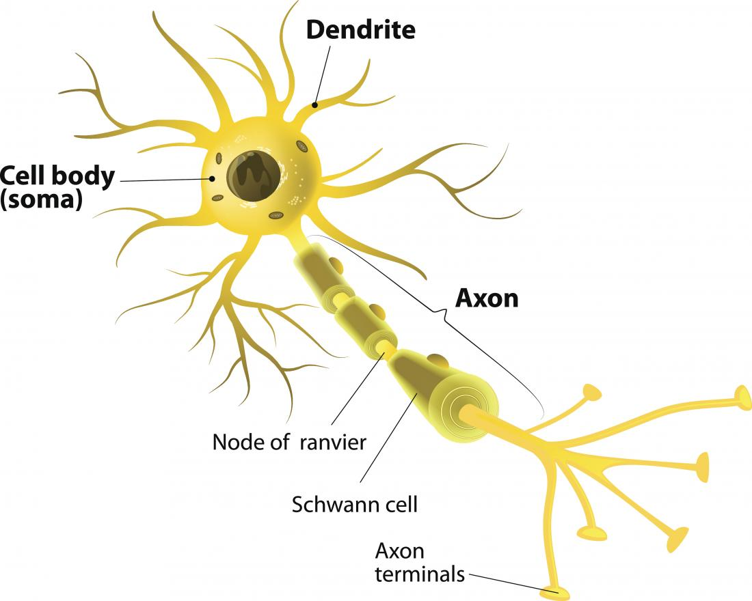
Neuronal structure
Cell body (soma) – coordinates and integrates signals, includes nucleus
Axon – transmits signals
Axon terminals – ends of axons, one side of synapses
Dendrites – receive signals
Myelin sheath – insulates axons
Nodes of Ranvier (myelin sheath gaps)
Organism
Organ systems
Organs
Tissues
Cells
Notes:
https://www.medicalnewstoday.com/articles/320289

Slide 9
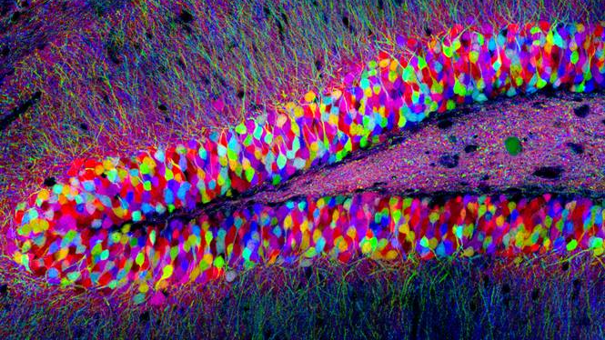
Notes:
<Day 1 – stop here and build neuron models>
https://www.cell.com/pictureshow/brainbow

Slide 10
Neuronal structure
Cell body (soma) – coordinates and integrates signals, includes nucleus
Axon – transmits signals
Axon terminals – ends of axons, one side of synapses
Dendrites – receive signals
Myelin sheath – insulates axons
Nodes of Ranvier (myelin sheath gaps)
Organism
Organ systems
Organs
Tissues
Cells
Notes:
https://www.medicalnewstoday.com/articles/320289

Slide 11
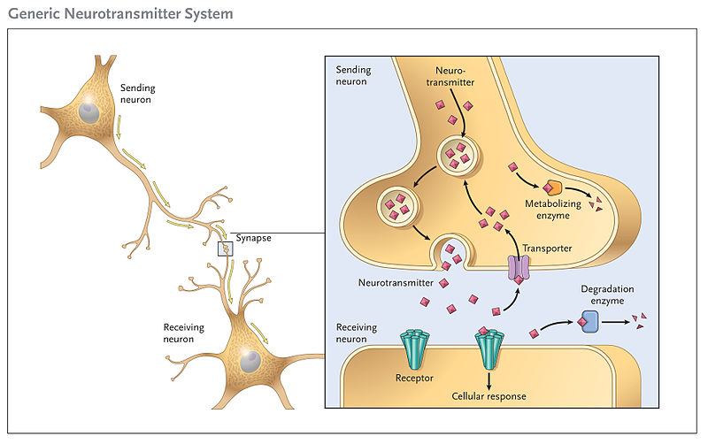
neurotransmission
Electrical and chemical signaling
Sending neuron sends electrical signal (action potential) toward axon terminals
Notes:
https://teachmephysiology.com/nervous-system/synapses/synaptic-transmission/

Slide 12
neurotransmission
Electrical and chemical signaling
Sending neuron sends electrical signal (action potential) toward axon terminals
Electrical signal transmitted to receiving neuron via chemical signals (neurotransmitters) across synapse
Notes:
https://teachmephysiology.com/nervous-system/synapses/synaptic-transmission/

Slide 13
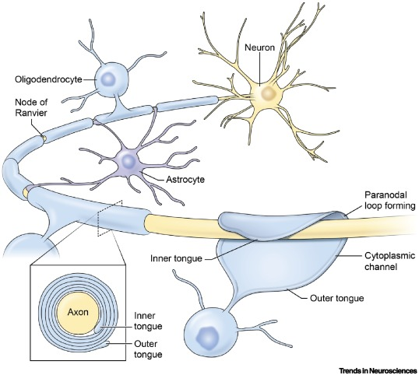
Myelination
Oligodendrocytes (CNS) and Schwann cells (PNS) produce myelin
Myelin wraps around neurons – like insulation around a wire
This “insulation” significantly increases the speed of action potentials
Notes:
https://www.cell.com/trends/neurosciences/fulltext/S0166-2236(19)30057-8

Slide 14
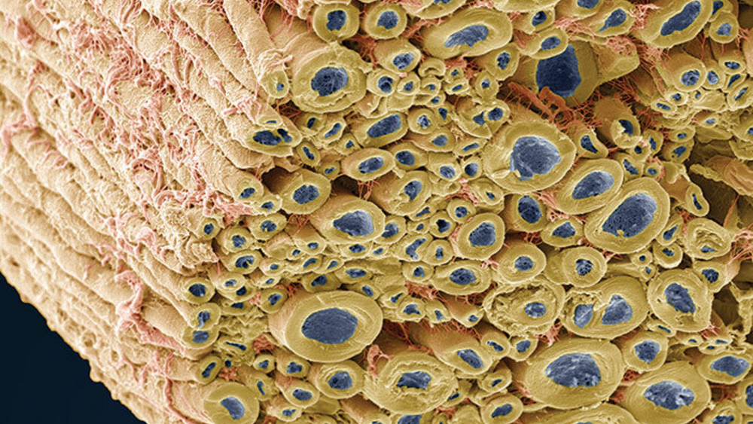
Notes:
<Play myelin game here>
https://thepathologist.com/subspecialties/image-of-the-month-1

Slide 15
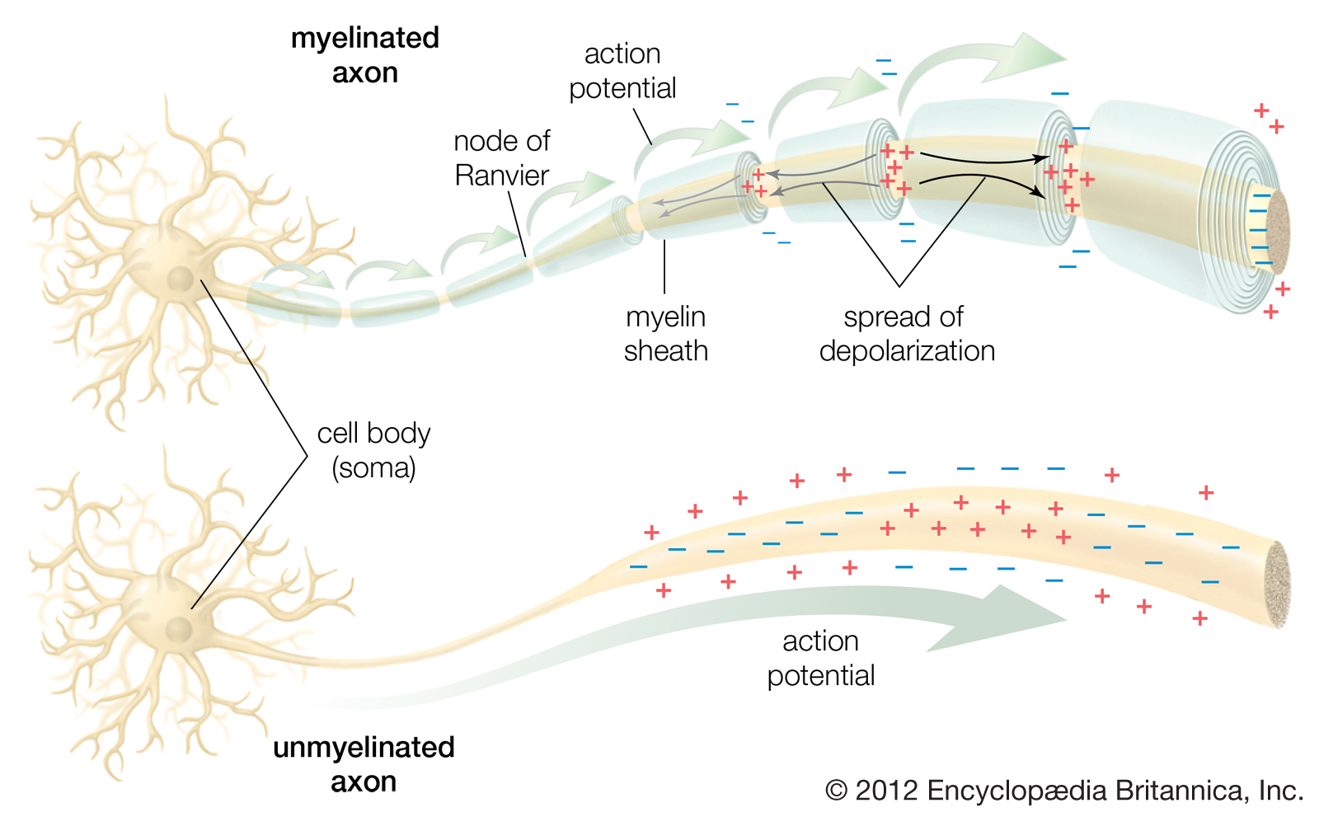
Saltatory Conduction

Slide 16
Saltatory Conduction
By Dr. Jana - http://docjana.com/saltatory-conduction/ ; https://www.patreon.com/posts/4374048, CC BY 4.0, https://commons.wikimedia.org/w/index.php?curid=46818964

Slide 17
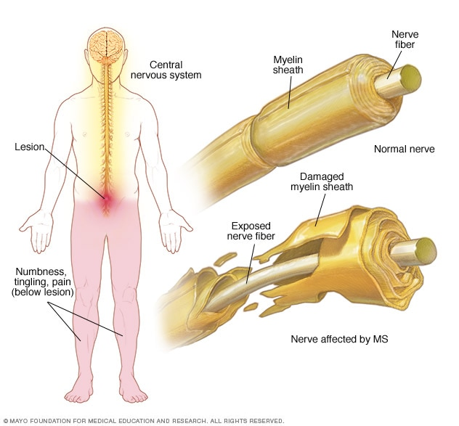
Multiple sclerosis (MS)
Autoimmune disorder in which the body’s immune system attacks myelin
Symptoms and severity vary widely depending on the effected neurons, but often include:
Numbness/weakness, tremor
Loss of vision, blurry vision
Fatigue, dizziness, cognitive impairment
Bladder/bowel dysfunction
Notes:
https://www.mayoclinic.org/diseases-conditions/multiple-sclerosis/symptoms-causes/syc-20350269

Slide 18
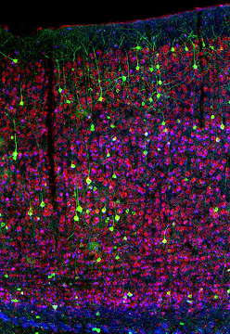
Summary
Nervous system is organized to enable communication all over the body
Neuron structure is essential to functional communication and connectivity
Myelination allows for significantly faster communication and complex behaviors
Notes:
https://www.the-scientist.com/daily-news/added-neurons-are-functionally-integrated-into-mouse-brain-circuits-32643

